Slide 1
Synthetic Materials
Chapter 2

Slide 2
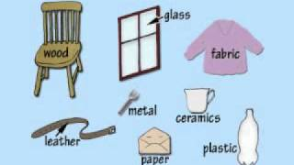
Materials
2 types
Natural materials
Synthetic materials

Slide 3
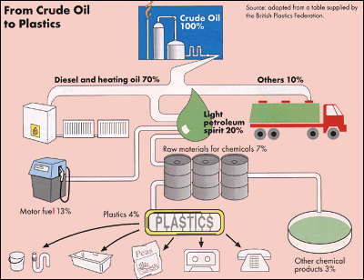
Plastic – made of crude petroleum oil
Also contain C,N,O,N,S,etc

Slide 4
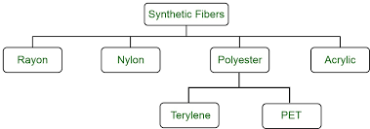
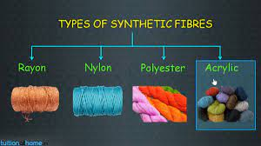
Synthetic fibres

Slide 5
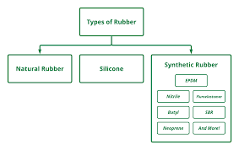
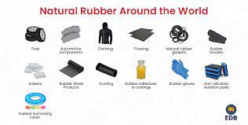
Rubber – Natural and Artificial rubber

Slide 6
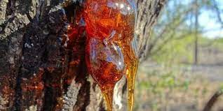
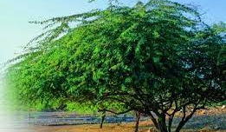
Adhesive – Glue used to stick things
Natural glue from plants – pine and keekar

